Slide 1
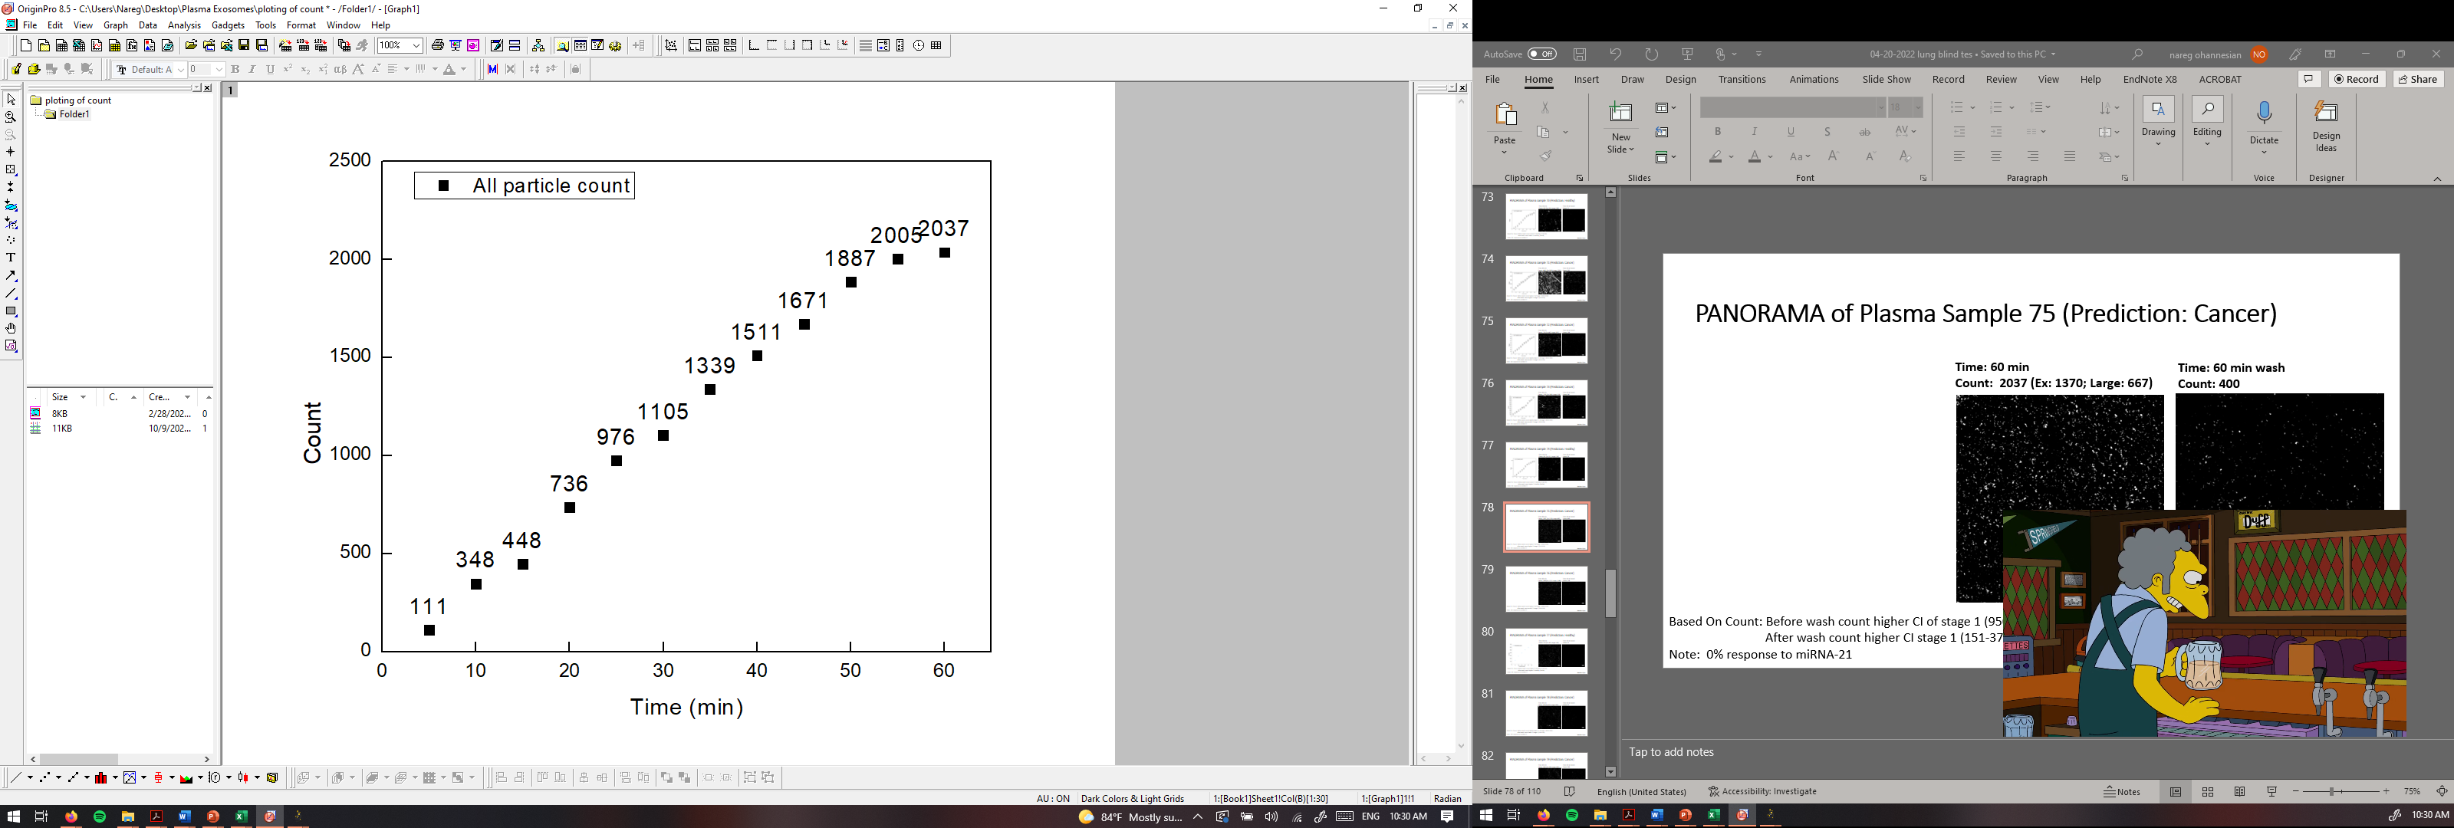
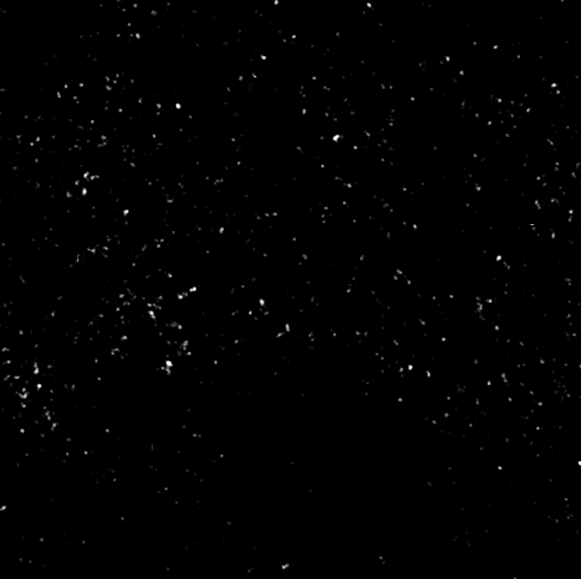
PANORAMA of Plasma Sample 75 (Prediction: Cancer)
Time: 60 min
Count: 2037 (Ex: 1370; Large: 667)
Time: 60 min wash
Count: 400
Based On Count: Before wash count higher CI of stage 1 (950-1558)
After wash count higher CI stage 1 (151-370)
Note: 0% response to miRNA-21
Scale bar: 10 µm

Slide 2
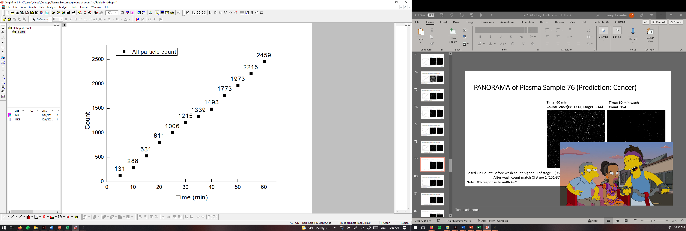

PANORAMA of Plasma Sample 76 (Prediction: Cancer)
Time: 60 min
Count: 2459 (Ex: 1315; Large: 1144)
Time: 60 min wash
Count: 154
Based On Count: Before wash count higher CI of stage 1 (950-1558)
After wash count match CI stage 1 (151-370)
Note: 0% response to miRNA-21
Scale bar: 10 µm

Slide 3
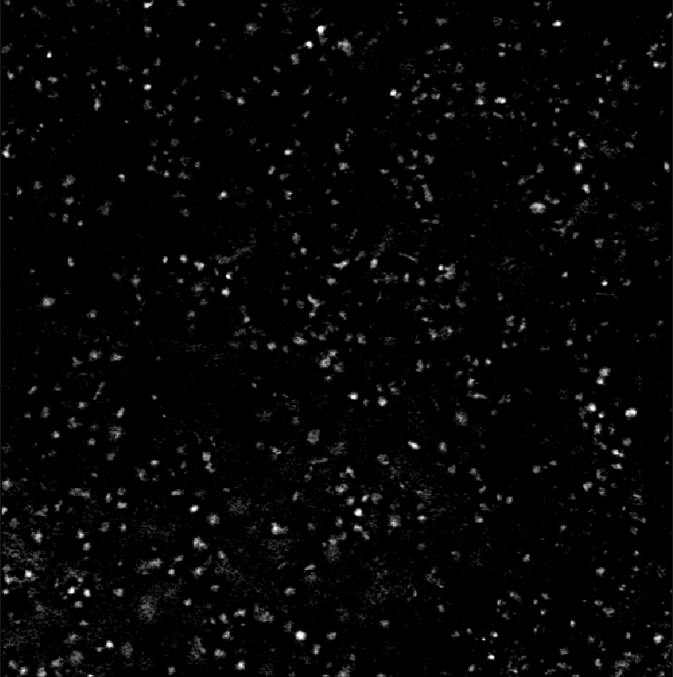

PANORAMA of Plasma Sample 77 (Prediction: Healthy)
Time: 60 min
Count: 310 (Ex: 167; Large: 143)
Time: 60 min wash
Count: 22
Based On Count: Before wash count higher CI Healthy (214-263)
After wash count higher CI Healthy (24-34)
Note: 0 % response to miRNA-21
Scale bar: 10 µm

Slide 4
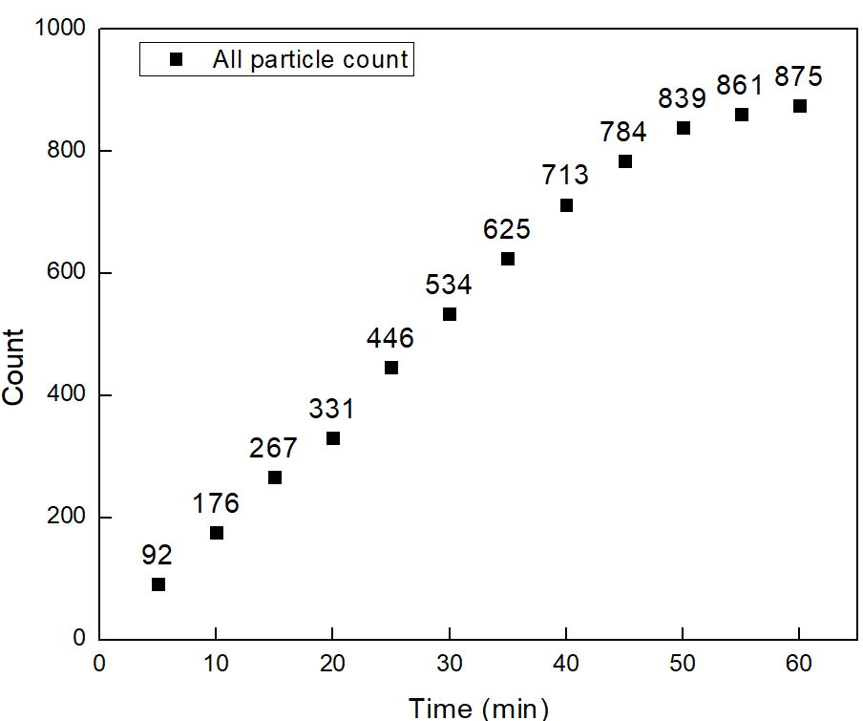

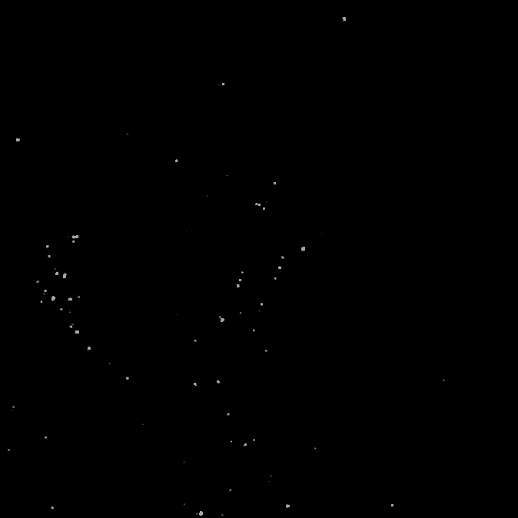
PANORAMA of Plasma Sample 78 (Prediction: Cancer)
Time: 60 min
Count: 875 (Ex: 673; Large: 202)
Time: 60 min wash
Count: 77
Based On Count: Before wash count slightly lower CI of stage 1 (950-1558)
After wash count lower CI stage 1 (151-370)
Note: 0% response to miRNA-21
Scale bar: 10 µm

Slide 5
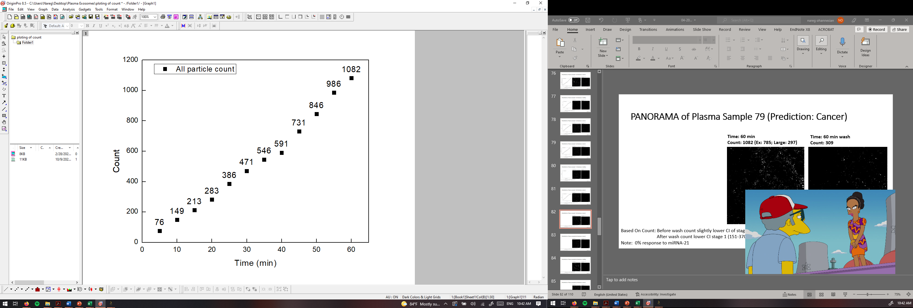
PANORAMA of Plasma Sample 79 (Prediction: Cancer)
Time: 60 min
Count: 1082 (Ex: 785; Large: 297)
Time: 60 min wash
Count: 309
Based On Count: Before wash count slightly lower CI of stage 1 (950-1558)
After wash count lower CI stage 1 (151-370)
Note: 0% response to miRNA-21
Scale bar: 10 µm

Slide 6
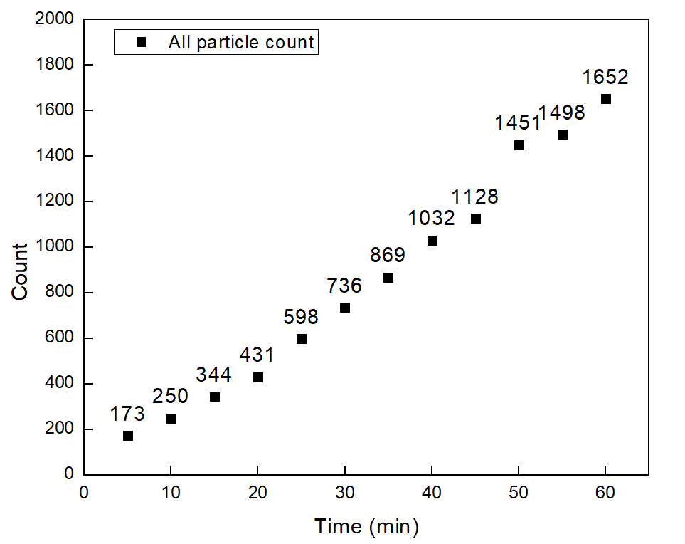


PANORAMA of Plasma Sample 53 (Prediction: Cancer)
Time: 60 min
Count: 1652 (Ex: 920; Large: 732)
Time: 60 min wash
Count: 470
Based On Count: Before wash count exceeds CI of stage 1 (950-1558)
After wash count exceeds CI stage 1 (151-370)
Note: 0% response to miRNA-21
Scale bar: 10 µm

Slide 7
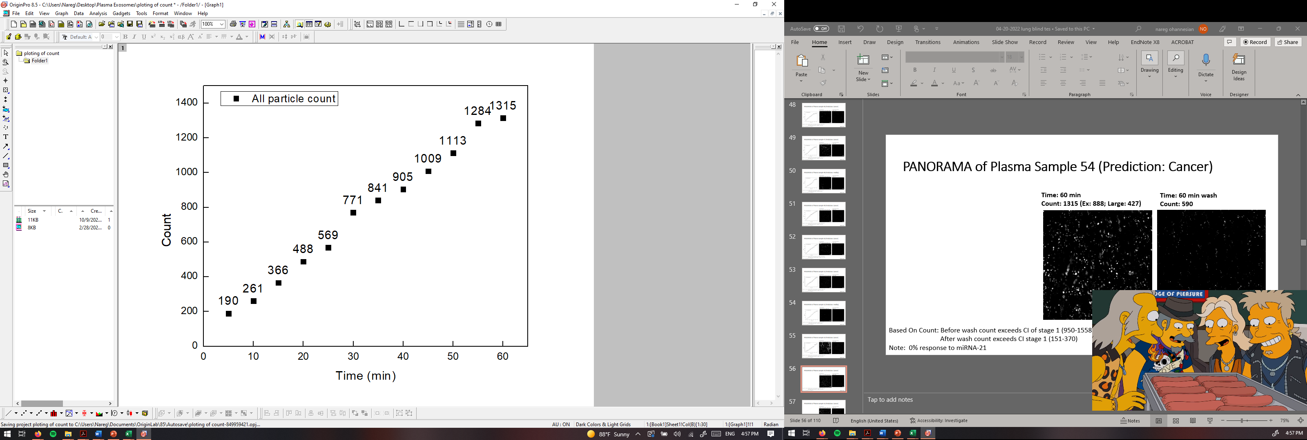
PANORAMA of Plasma Sample 54 (Prediction: Cancer)
Time: 60 min
Count: 1315 (Ex: 888; Large: 427)
Time: 60 min wash
Count: 590
Based On Count: Before wash count exceeds CI of stage 1 (950-1558)
After wash count exceeds CI stage 1 (151-370)
Note: 0% response to miRNA-21
Scale bar: 10 µm

Slide 8
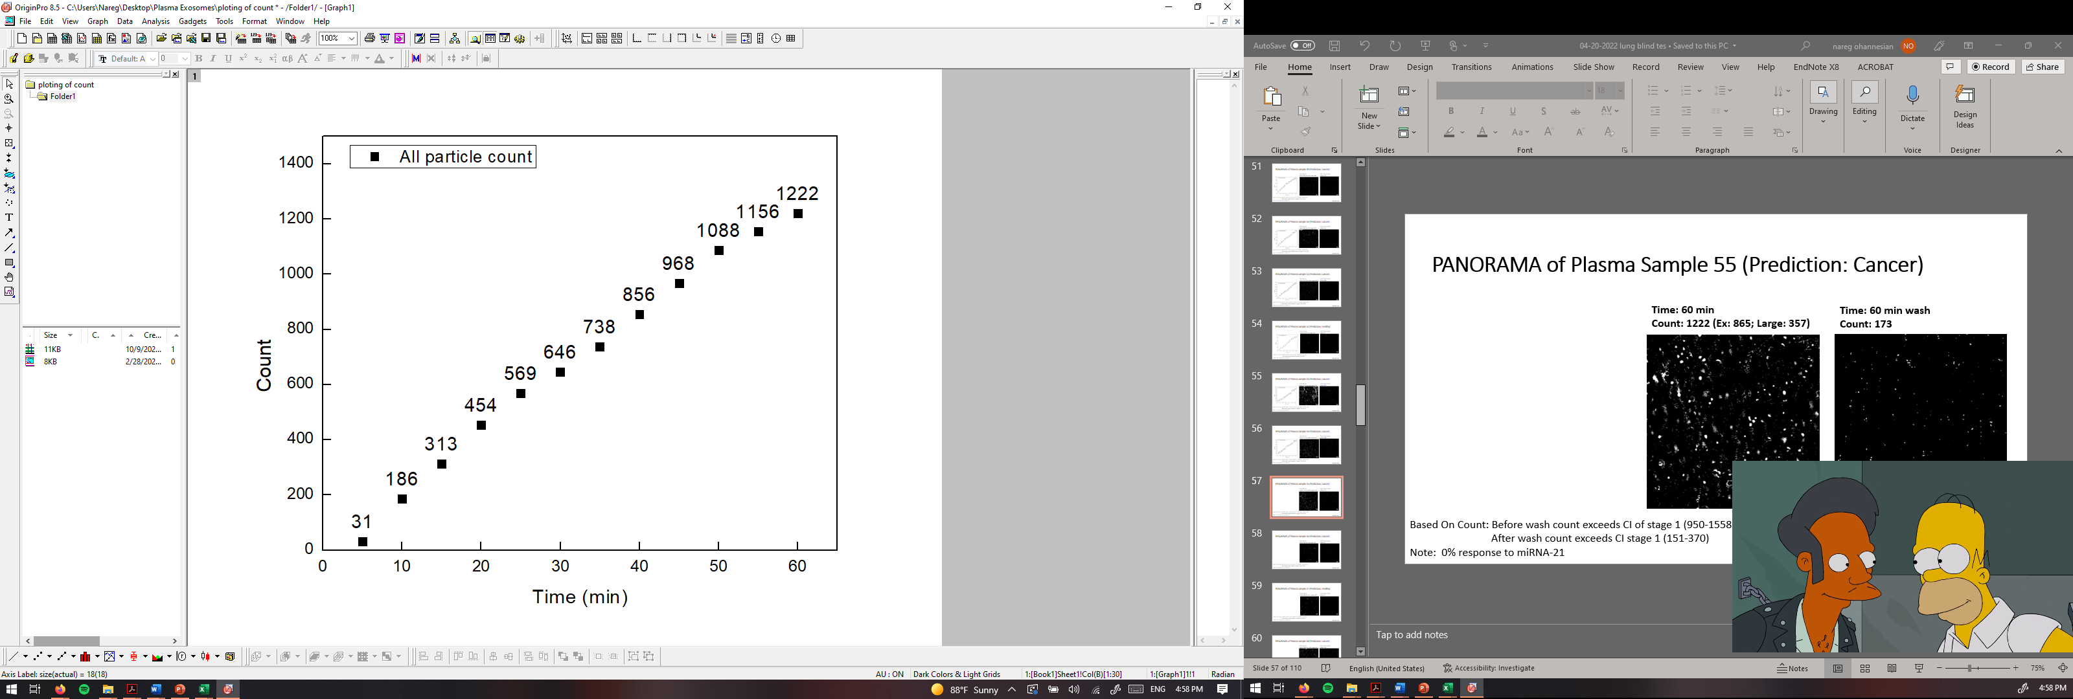

PANORAMA of Plasma Sample 55 (Prediction: Cancer)
Time: 60 min
Count: 1222 (Ex: 865; Large: 357)
Time: 60 min wash
Count: 173
Based On Count: Before wash count exceeds CI of stage 1 (950-1558)
After wash count exceeds CI stage 1 (151-370)
Note: 0% response to miRNA-21
Scale bar: 10 µm

Slide 9
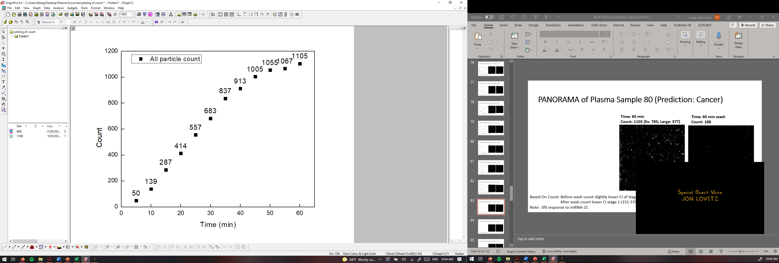
PANORAMA of Plasma Sample 80 (Prediction: Cancer)
Time: 60 min
Count: 1105 (Ex: 785; Large: 377)
Time: 60 min wash
Count: 188
Based On Count: Before wash count slightly lower CI of stage 1 (950-1558)
After wash count lower CI stage 1 (151-370)
Note: 0% response to miRNA-21
Scale bar: 10 µm

Slide 10
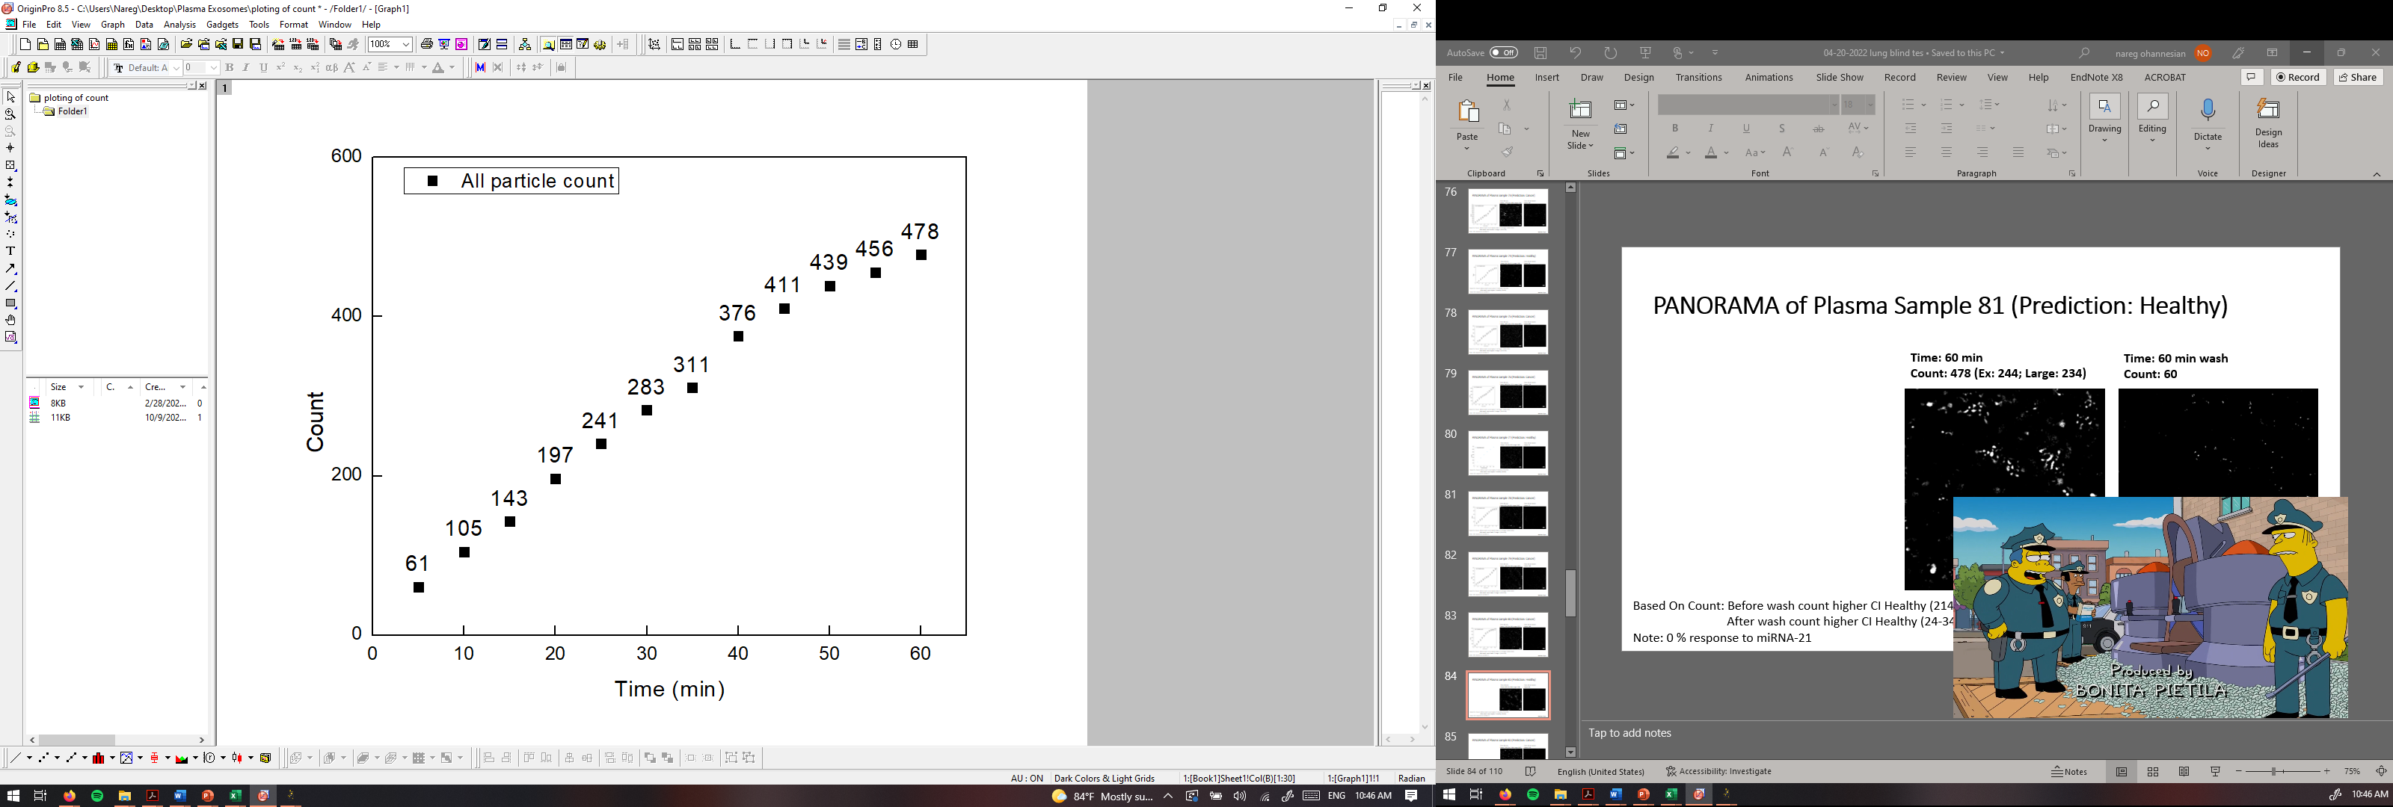

PANORAMA of Plasma Sample 81 (Prediction: Healthy)
Time: 60 min
Count: 478 (Ex: 244; Large: 234)
Time: 60 min wash
Count: 60
Based On Count: Before wash count higher CI Healthy (214-263)
After wash count higher CI Healthy (24-34)
Note: 0 % response to miRNA-21
Scale bar: 10 µm

Slide 11
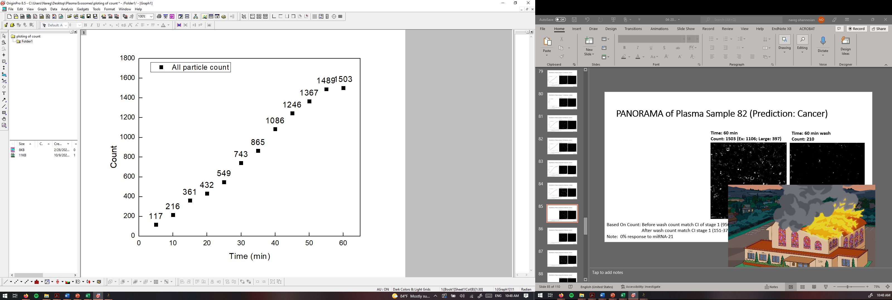
PANORAMA of Plasma Sample 82 (Prediction: Cancer)
Time: 60 min
Count: 1503 (Ex: 1106; Large: 397)
Time: 60 min wash
Count: 210
Based On Count: Before wash count match CI of stage 1 (950-1558)
After wash count match CI stage 1 (151-370)
Note: 0% response to miRNA-21
Scale bar: 10 µm

Slide 12
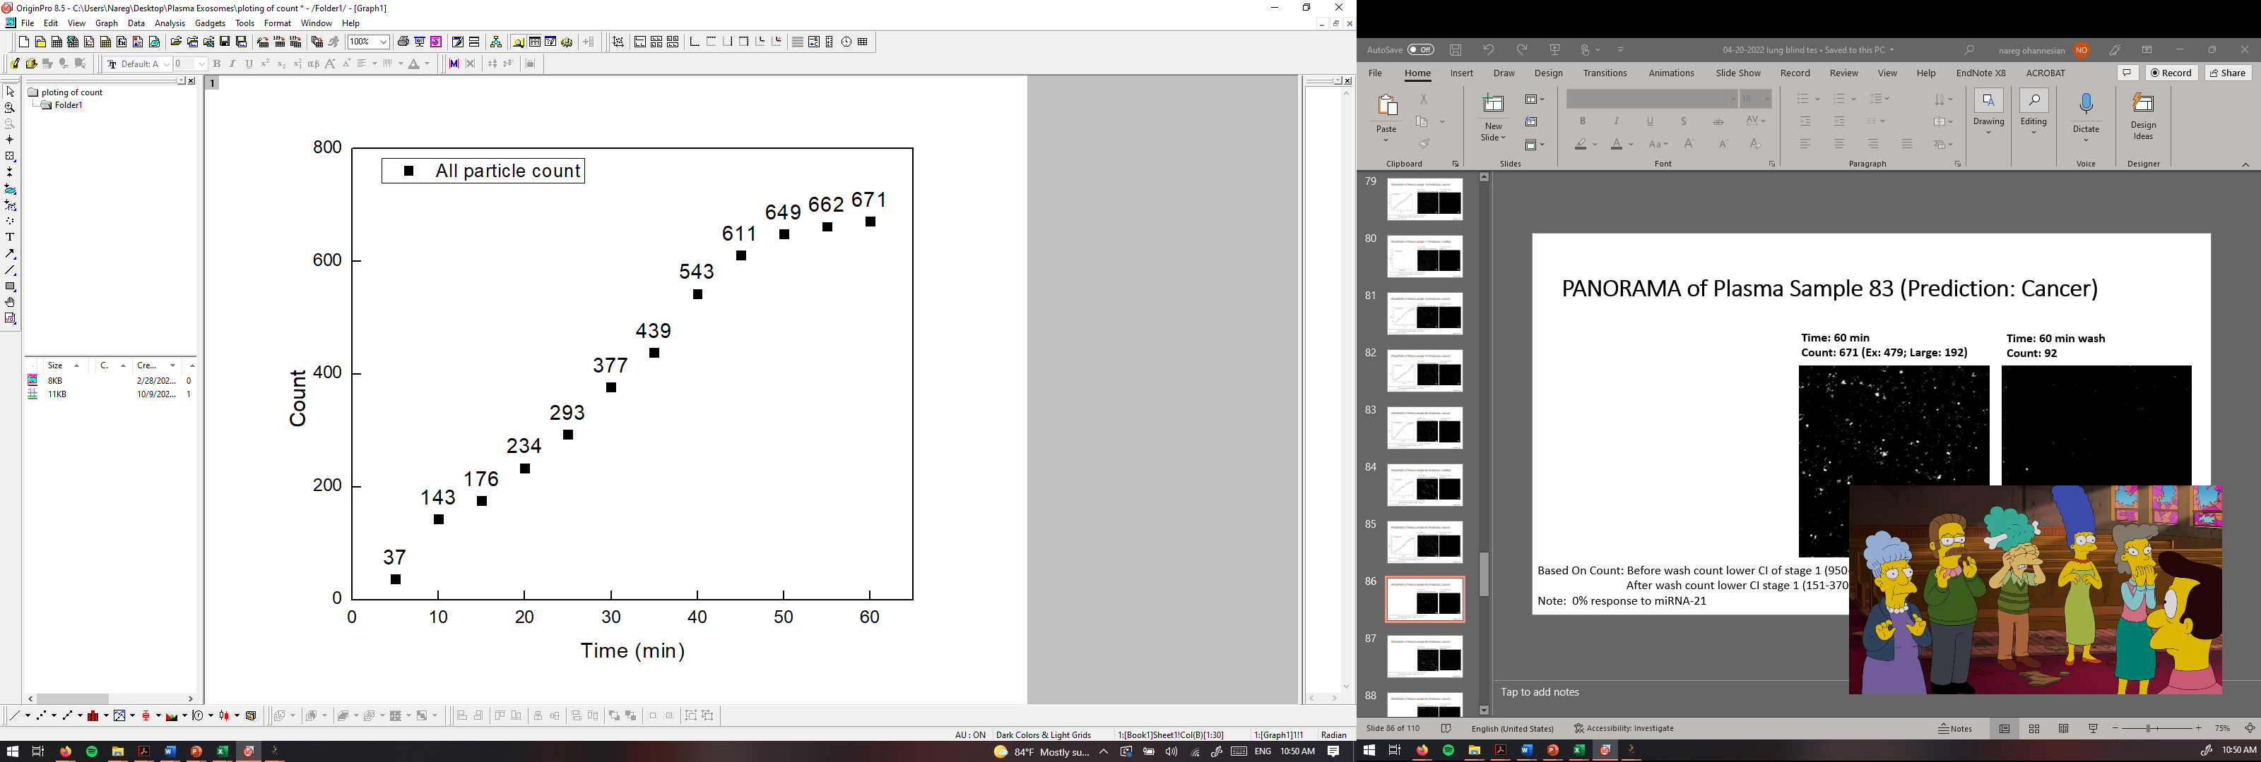
PANORAMA of Plasma Sample 83 (Prediction: Cancer)
Time: 60 min
Count: 671 (Ex: 479; Large: 192)
Time: 60 min wash
Count: 92
Based On Count: Before wash count lower CI of stage 1 (950-1558)
After wash count lower CI stage 1 (151-370)
Note: 0% response to miRNA-21
Scale bar: 10 µm

Slide 13
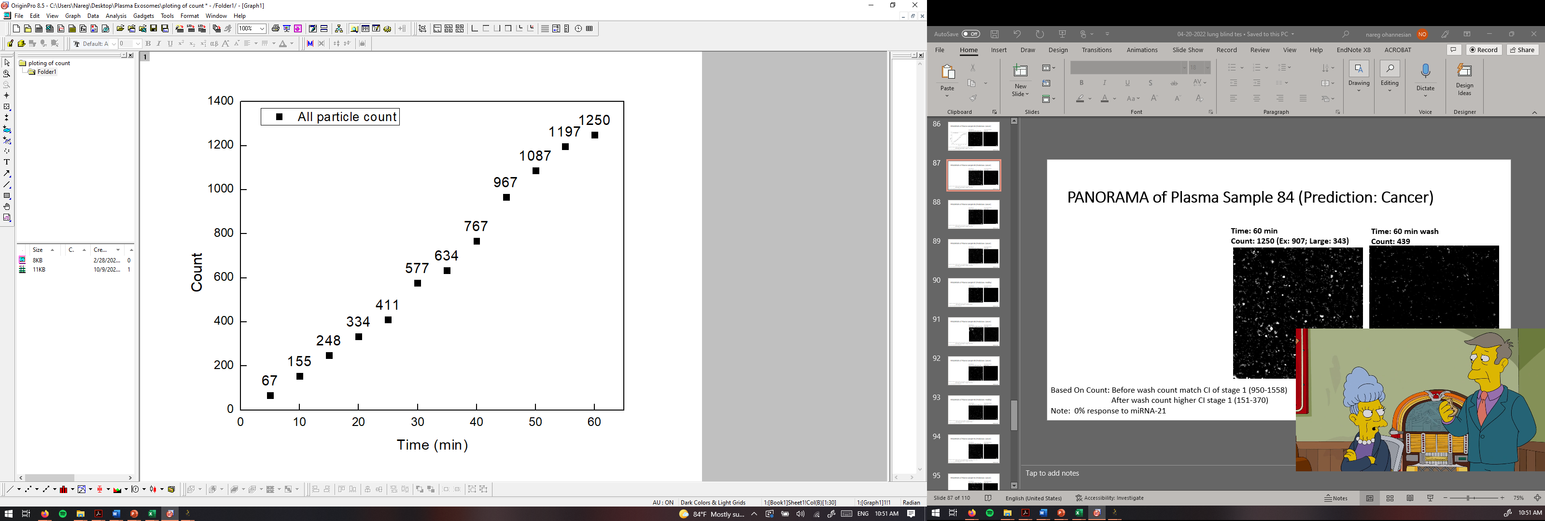
PANORAMA of Plasma Sample 84 (Prediction: Cancer)
Time: 60 min
Count: 1250 (Ex: 907; Large: 343)
Time: 60 min wash
Count: 439
Based On Count: Before wash count match CI of stage 1 (950-1558)
After wash count higher CI stage 1 (151-370)
Note: 0% response to miRNA-21
Scale bar: 10 µm

Slide 14
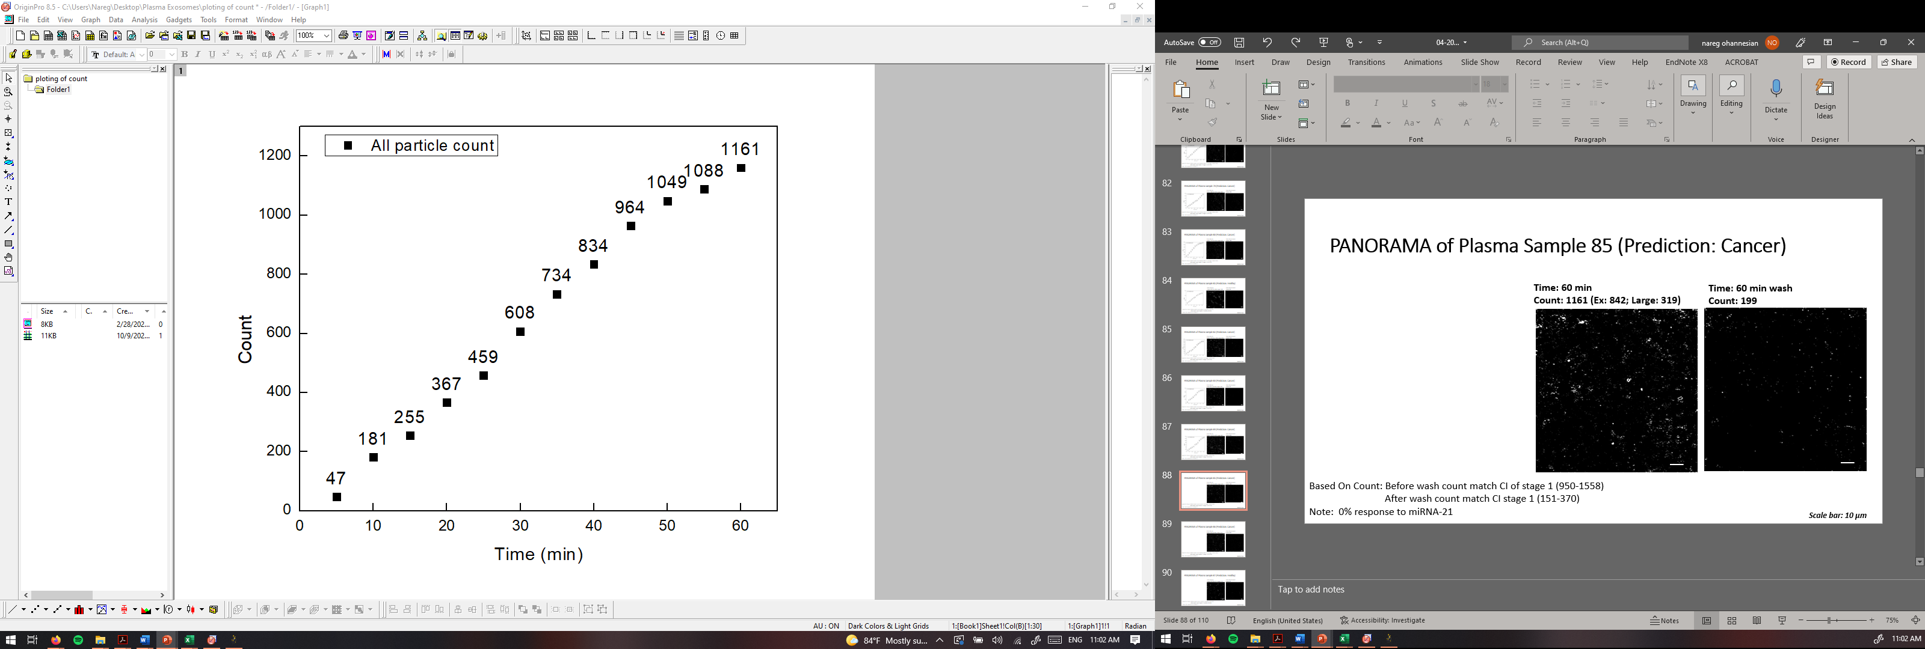

PANORAMA of Plasma Sample 85 (Prediction: Cancer)
Time: 60 min
Count: 1161 (Ex: 842; Large: 319)
Time: 60 min wash
Count: 199
Based On Count: Before wash count match CI of stage 1 (950-1558)
After wash count match CI stage 1 (151-370)
Note: 0% response to miRNA-21
Scale bar: 10 µm

Slide 15
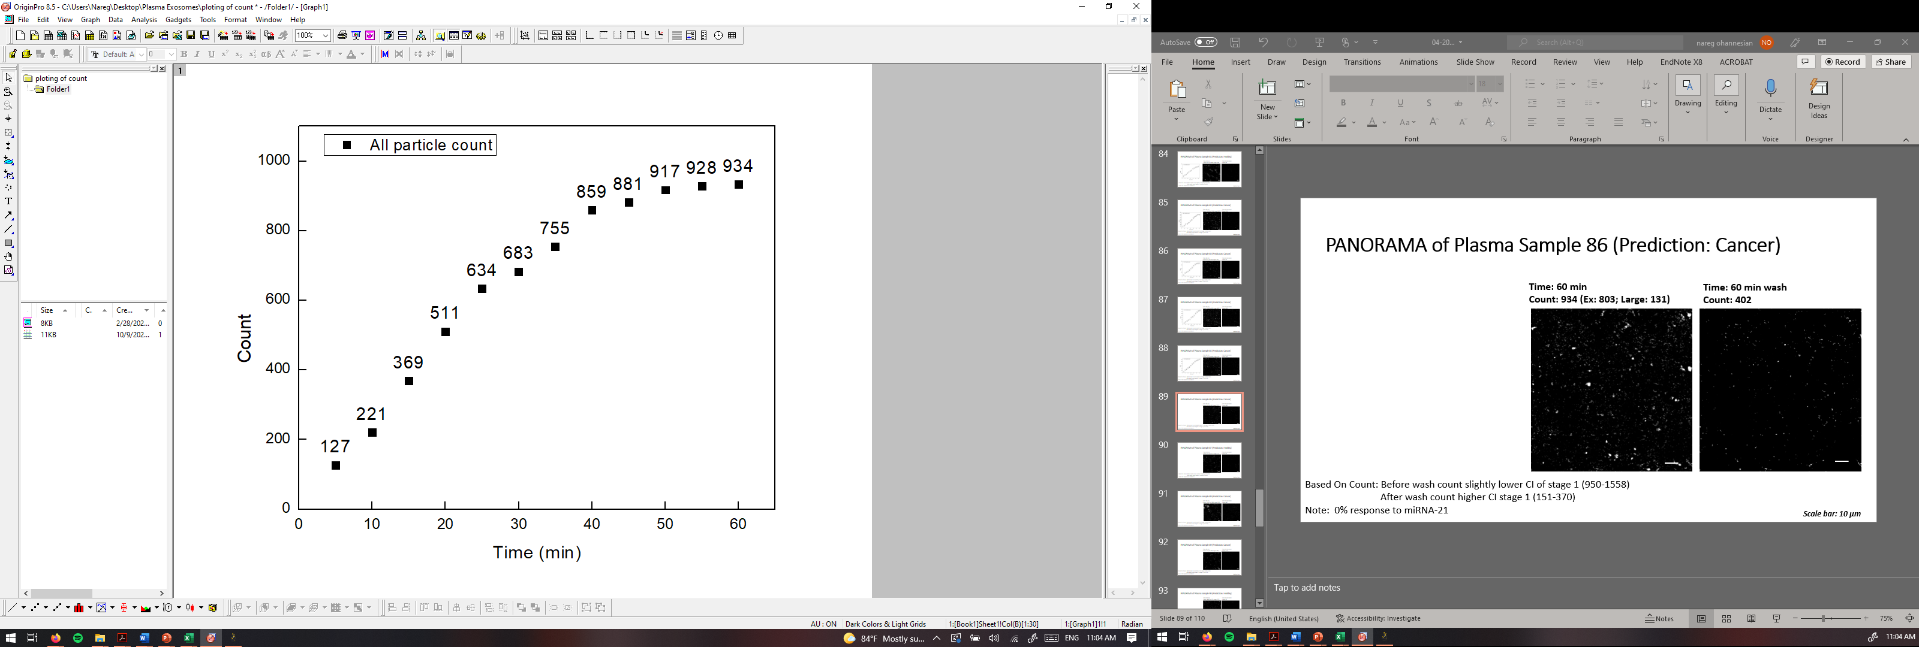
PANORAMA of Plasma Sample 86 (Prediction: Cancer)
Time: 60 min
Count: 934 (Ex: 803; Large: 131)
Time: 60 min wash
Count: 402
Based On Count: Before wash count slightly lower CI of stage 1 (950-1558)
After wash count higher CI stage 1 (151-370)
Note: 0% response to miRNA-21
Scale bar: 10 µm

Slide 16

PANORAMA of Plasma Sample 87 (Prediction: Healthy)
Time: 60 min
Count: 232 (Ex: 121; Large: 111)
Time: 60 min wash
Count: 63
Based On Count: Before wash count match CI Healthy (214-263)
After wash count higher CI Healthy (24-34)
Note: 0 % response to miRNA-21
Scale bar: 10 µm

Slide 17
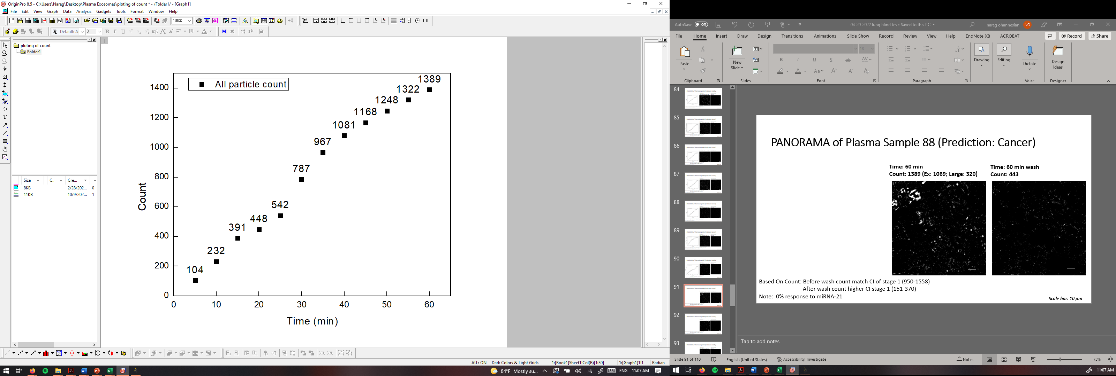
PANORAMA of Plasma Sample 88 (Prediction: Cancer)
Time: 60 min
Count: 1389 (Ex: 1069; Large: 320)
Time: 60 min wash
Count: 443
Based On Count: Before wash count match CI of stage 1 (950-1558)
After wash count higher CI stage 1 (151-370)
Note: 0% response to miRNA-21
Scale bar: 10 µm

Slide 18
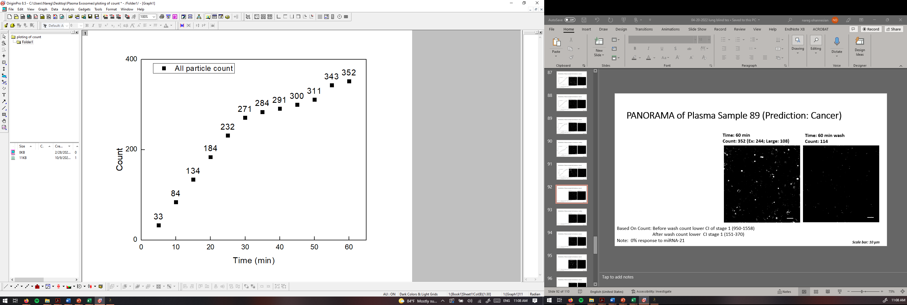
PANORAMA of Plasma Sample 89 (Prediction: Cancer)
Time: 60 min
Count: 352 (Ex: 244; Large: 108)
Time: 60 min wash
Count: 114
Based On Count: Before wash count lower CI of stage 1 (950-1558)
After wash count lower CI stage 1 (151-370)
Note: 0% response to miRNA-21
Scale bar: 10 µm

Slide 19
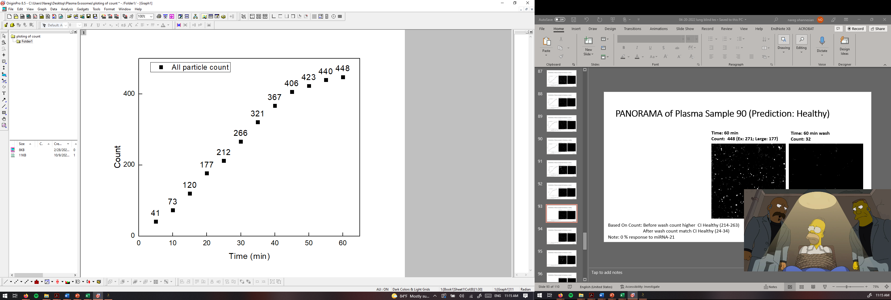
PANORAMA of Plasma Sample 90 (Prediction: Healthy)
Time: 60 min
Count: 448 (Ex: 271; Large: 177)
Time: 60 min wash
Count: 32
Based On Count: Before wash count higher CI Healthy (214-263)
After wash count match CI Healthy (24-34)
Note: 0 % response to miRNA-21
Scale bar: 10 µm

Slide 20
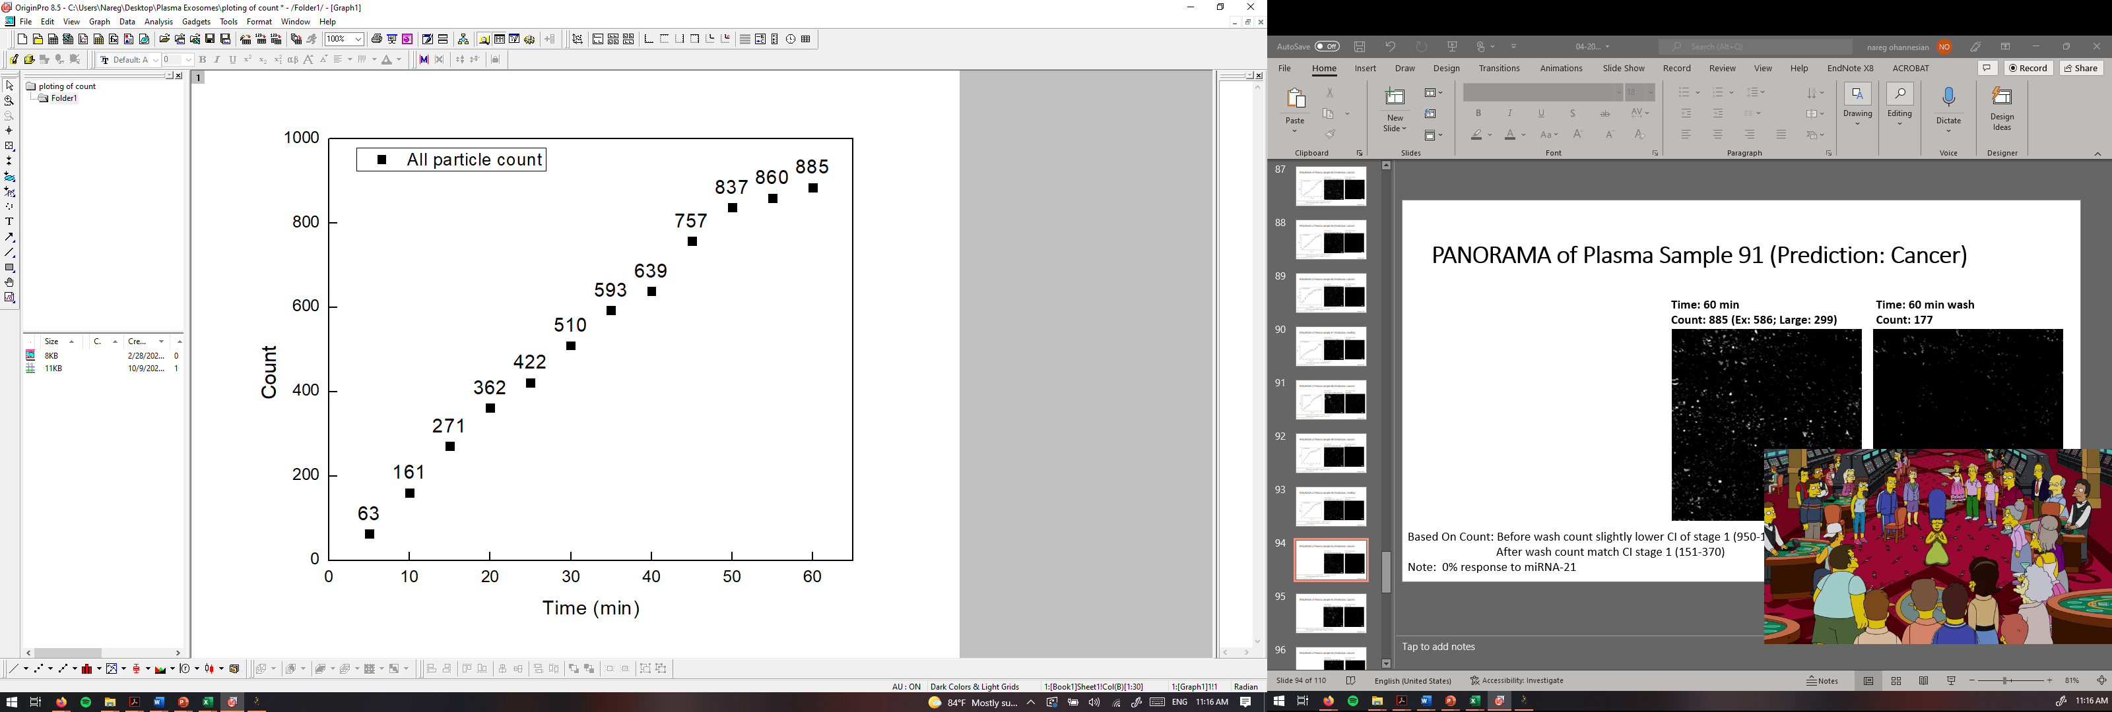
PANORAMA of Plasma Sample 91 (Prediction: Cancer)
Time: 60 min
Count: 885 (Ex: 586; Large: 299)
Time: 60 min wash
Count: 177
Based On Count: Before wash count slightly lower CI of stage 1 (950-1558)
After wash count match CI stage 1 (151-370)
Note: 0% response to miRNA-21
Scale bar: 10 µm

Slide 21
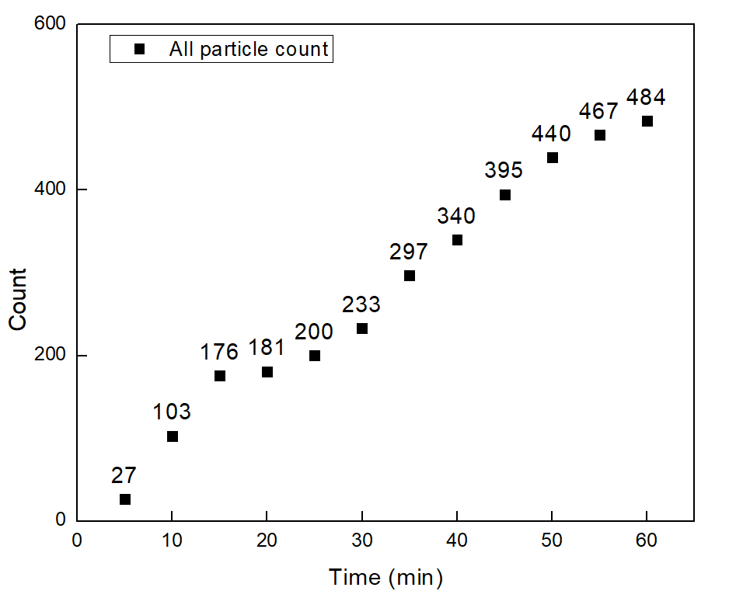
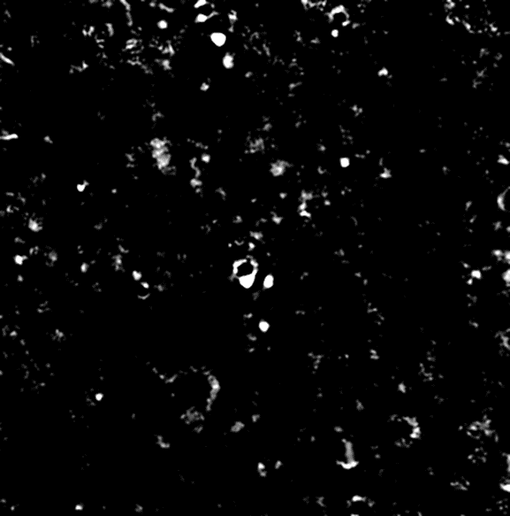

PANORAMA of Plasma Sample 92 (Prediction: Cancer)
Time: 60 min
Count: 484 (Ex: 244; Large: 204)
Time: 60 min wash
Count: 143
Based On Count: Before wash count lower CI of stage 1 (950-1558)
After wash count slightly lower CI stage 1 (151-370)
Note: 0% response to miRNA-21
Scale bar: 10 µm

Slide 22
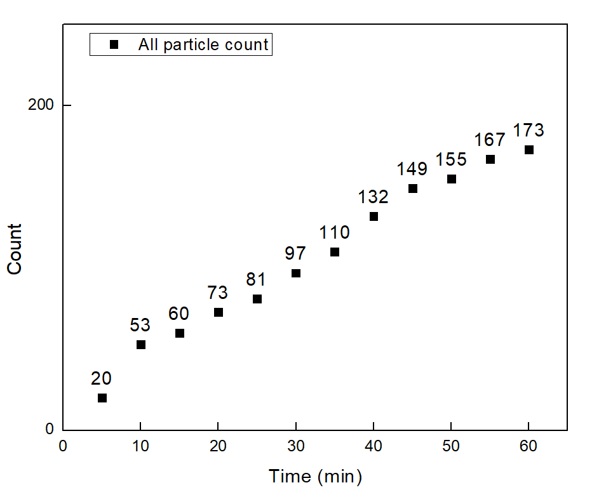


PANORAMA of Plasma Sample 93 (Prediction: Cancer)
Time: 60 min
Count: 173 (Ex: 140; Large: 38)
Time: 60 min wash
Count: 101
Based On Count: Before wash count lower CI of stage 1 (950-1558)
After wash count lower CI stage 1 (151-370)
Note: 0% response to miRNA-21
Scale bar: 10 µm

Slide 23
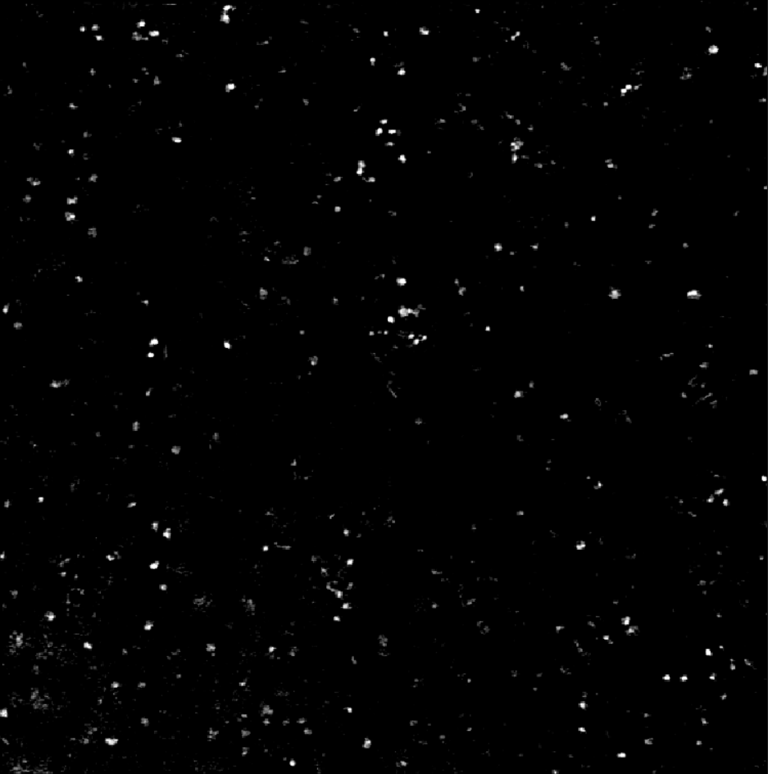

PANORAMA of sample 94
Before wash particles: 463
Large particle: 109
Exosome: 354
After wash exosome: 63
Note: 0% response to miRNA-21
Looks healthy
Scale Bar: 10 µm

Slide 24


PANORAMA of sample 95
Before wash particles: 243
Large particle: 42
Exosome: 201
After wash exosome: 101
Note: 0% response to miRNA-21
Looks cancerous
Scale Bar: 10 µm

Slide 25
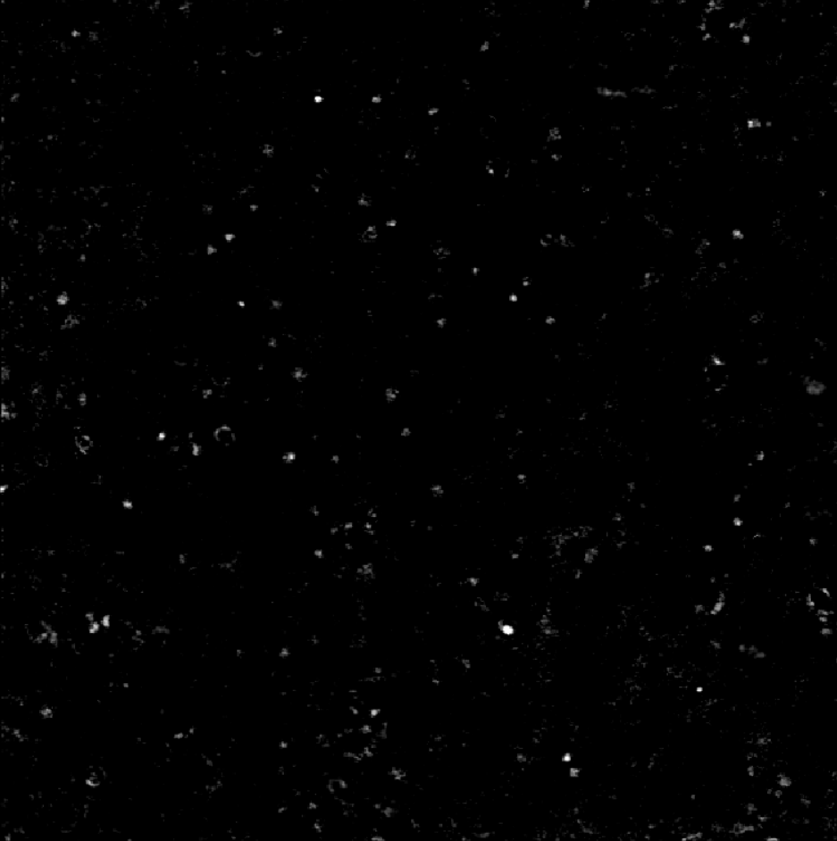

PANORAMA of sample 96
Before wash particles: 325
Large particle: 63
Exosome: 262
After wash exosome: 121
Note: 0% response to miRNA-21
Looks cancerous
Scale Bar: 10 µm

Slide 26
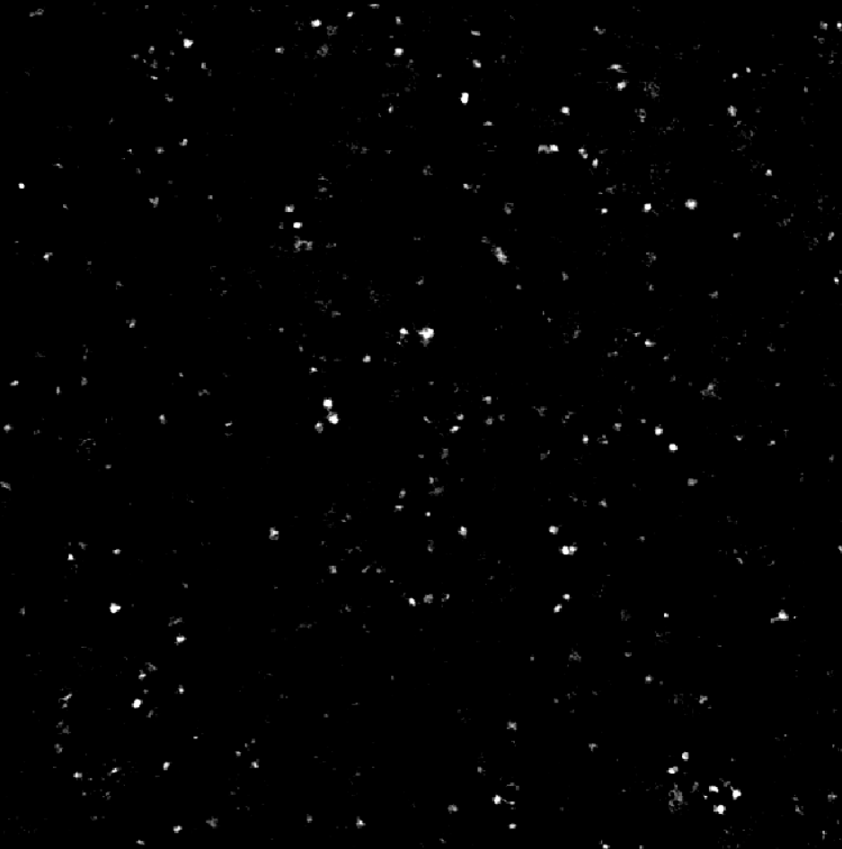

PANORAMA of sample 97
Before wash particles: 399
Large particle: 99
Exosome: 300
After wash exosome: 49
Note: 0% response to miRNA-21
Looks healthy
Scale Bar: 10 µm

Slide 27
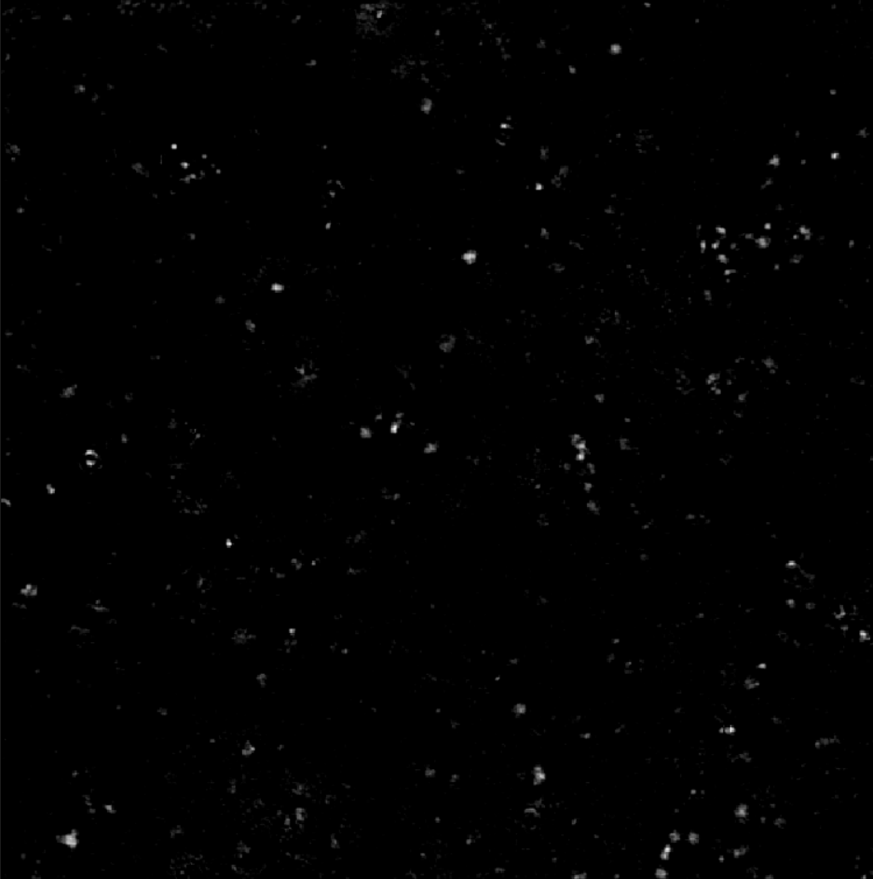

PANORAMA of sample 98
Before wash particles: 429
Large particle: 52
Exosome: 377
After wash exosome: 56
Note: 0% response to miRNA-21
Looks healthy
Scale Bar: 10 µm

Slide 28
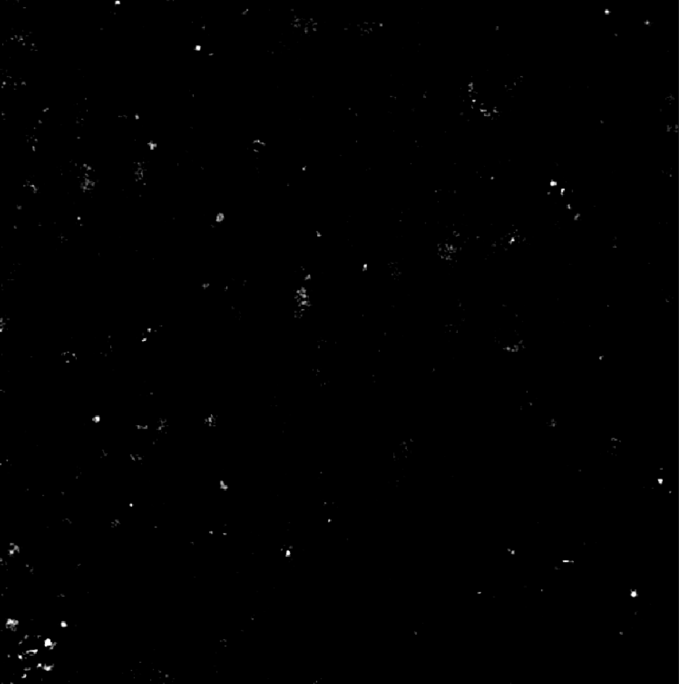

PANORAMA of sample 99
Before wash particles: 248
Large particle: 25
Exosome: 223
After wash exosome: 59
Note: 0% response to miRNA-21
Looks healthy
Scale Bar: 10 µm

Slide 29
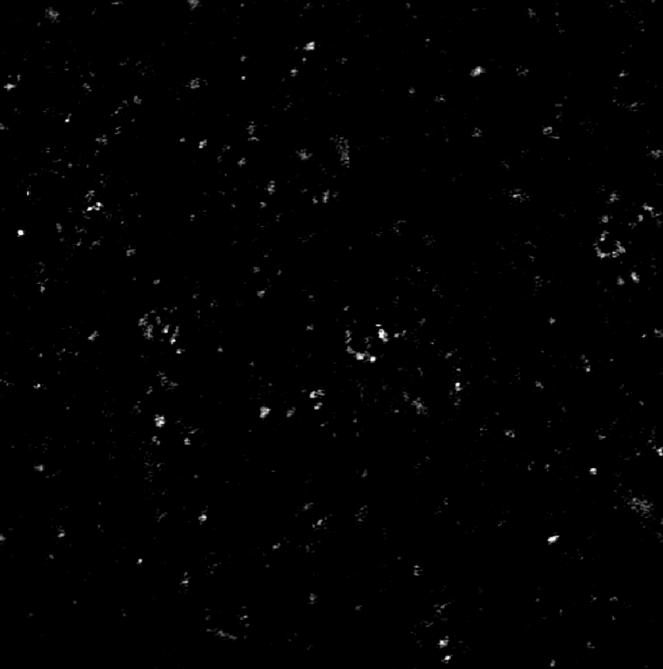

PANORAMA of sample 100
Before wash particles: 275
Large particle: 70
Exosome: 205
After wash exosome: 68
Note: 0% response to miRNA-21
Looks healthy
Scale Bar: 10 µm

Slide 30
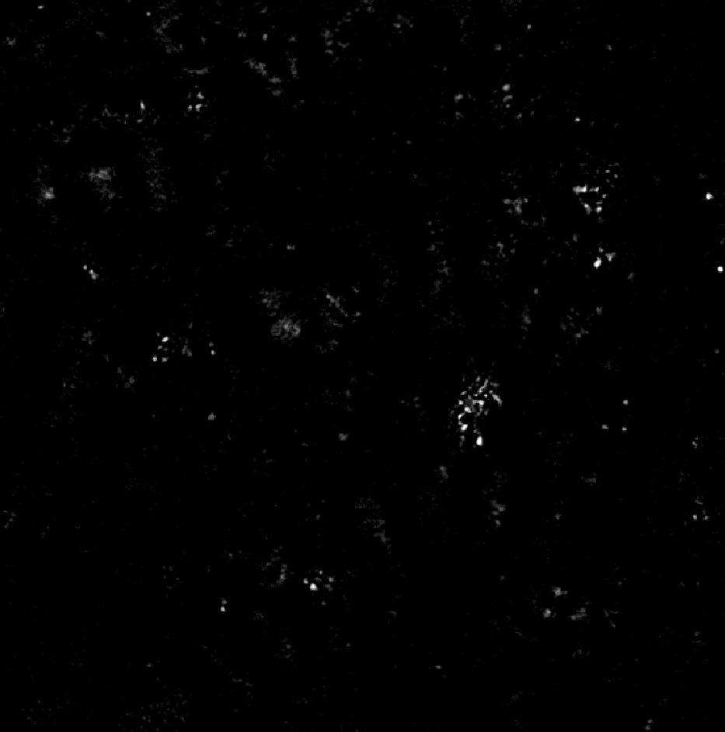

PANORAMA of sample 101
Before wash particles: 358
Large particle: 40
Exosome: 315
After wash exosome: 98
Note: 0% response to miRNA-21
Looks cancerous
Scale Bar: 10 µm

Slide 31
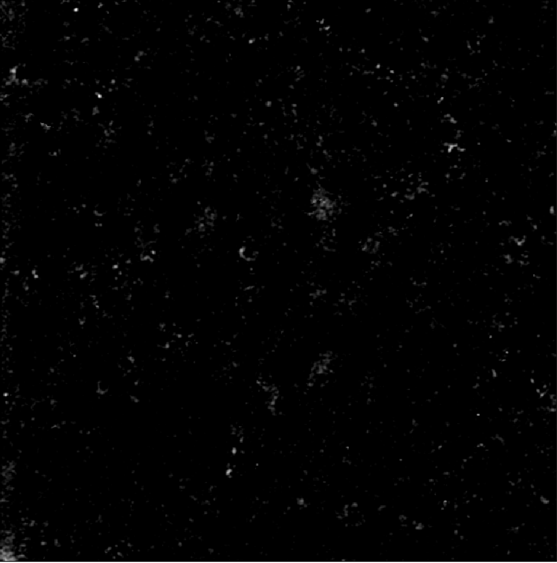

PANORAMA of sample 102
Before wash particles: 398
Large particle: 15
Exosome: 383
After wash exosome: 120
Note: 0% response to miRNA-21
Looks cancerous
Scale Bar: 10 µm

Slide 32


PANORAMA of sample 103
Before wash particles: 233
Large particle: 32
Exosome: 201
After wash exosome: 65
Note: 0% response to miRNA-21
Looks healthy
Scale Bar: 10 µm

Slide 33
Number | Total | Large | Exosome | Retained | MIR-21 | Prediction | State | Sample
70 | 203 | 100 | 103 | 11 | 0 | Healthy | Healthy | 11UH
71 | 4411 | 1761 | 2650 | 1064 | 0 | Cancer | Cancer | 0310-226
72 | 750 | 283 | 467 | 198 | 0 | Cancer | Cancer | 0310-231
73 | 1379 | 314 | 1065 | 241 | 0 | Cancer | Cancer | 0310-228
74 | 361 | 130 | 231 | 70 | 0 | Healthy | Healthy | 12UH
75 | 2037 | 667 | 1370 | 400 | 0 | Cancer | Cancer | 0310-221
76 | 2459 | 1144 | 1315 | 154 |  | Cancer | Cancer | 0310-229
77 | 669 | 204 | 465 | 63 | 0 | Healthy | Healthy | 506-7
78 | 875 | 202 | 673 | 77 | 0 | Cancer | Cancer | 0310-222
79 | 1082 | 297 | 785 | 309 | 0 | Cancer | Cancer | 0310-223
80 | 1105 | 377 | 728 | 188 | 0 | Cancer | Cancer | 0310-227
81 | 478 | 234 | 244 | 60 | 0 | Healthy | Healthy | 13UH
82 | 1503 | 397 | 1106 | 210 | 0 | Cancer | Cancer | 0310-230
83 | 671 | 192 | 479 | 92 | 0 | Cancer | Cancer | 0310-219
84 | 1250 | 343 | 907 | 439 | 0 | Cancer | Cancer | 0310-218
85 | 1161 | 319 | 842 | 199 | 0 | Cancer | Cancer | 0310-220
86 | 934 | 131 | 803 | 402 | 0 | Cancer | Cancer | 0310-214
87 | 232 | 111 | 121 | 63 | 0 | Healthy | Healthy | 14UH
88 | 1389 | 320 | 1069 | 443 | 0 | Cancer | Cancer | 0310-255
89 | 352 | 108 | 244 | 114 | 0 | Cancer | Cancer | 0310-217
90 | 448 | 177 | 271 | 32 | 0 | Healthy | Healthy | 15UH
91 | 885 | 299 | 586 | 177 | 0 | Cancer | Cancer | 0310-215
92 | 484 | 240 | 244 | 143 | 0 | Cancer | Cancer | 0310-216
93 | 178 | 38 | 140 | 101 | 0 | Cancer | Cancer | 0310-224
94 | 463 | 109 | 354 | 63 | 0 | Healthy | Healthy | 502-3
95 | 243 | 42 | 201 | 101 | 0 | Cancer | Cancer | 0310-233
96 | 325 | 63 | 262 | 121 | 0 | Cancer | Cancer | 0310-234
97 | 399 | 99 | 300 | 49 | 0 | Healthy | Healthy | 500-1
98 | 429 | 52 | 377 | 56 | 0 | Healthy | Healthy | UH 17
99 | 248 | 25 | 223 | 59 | 0 | Healthy | Healthy | UH 18
100 | 275 | 70 | 205 | 68 | 0 | Healthy | Healthy | UH 21
101 | 358 | 40 | 318 | 98 | 0 | Cancer | Cancer | 0310-237
102 | 398 | 15 | 383 | 120 | 0 | Cancer | Cancer | 0310-236
103 | 233 | 32 | 201 | 65 | 0 | Healthy | Healthy | UH 22

Slide 34
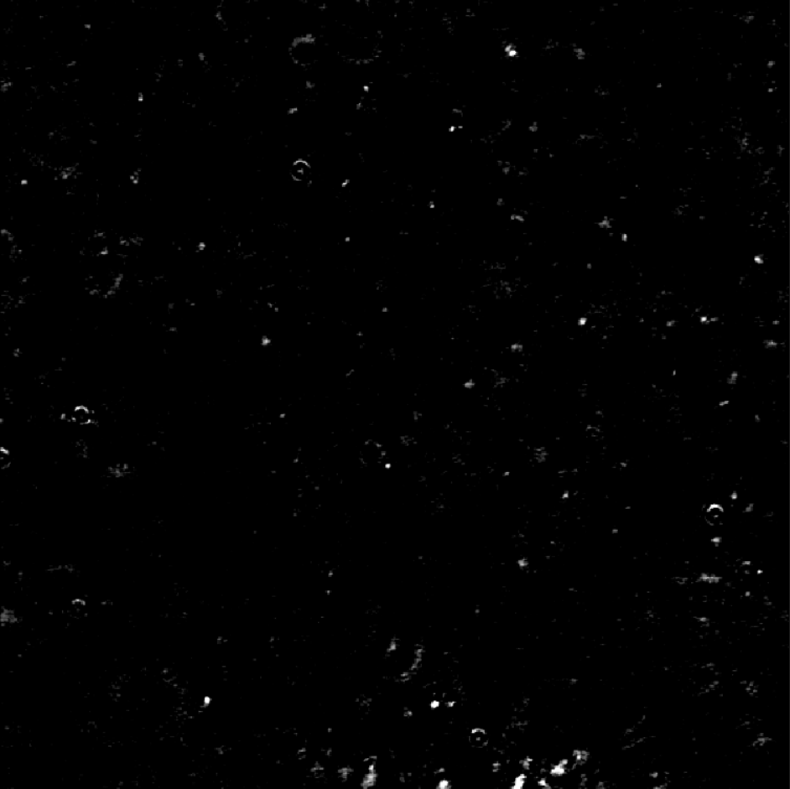

PANORAMA of sample 104
Before wash particles: 301
Large particle: 22
Exosome:
After wash exosome: 42
Note: 0% response to miRNA-21
Looks healthy
Scale Bar: 10 µm

Slide 35
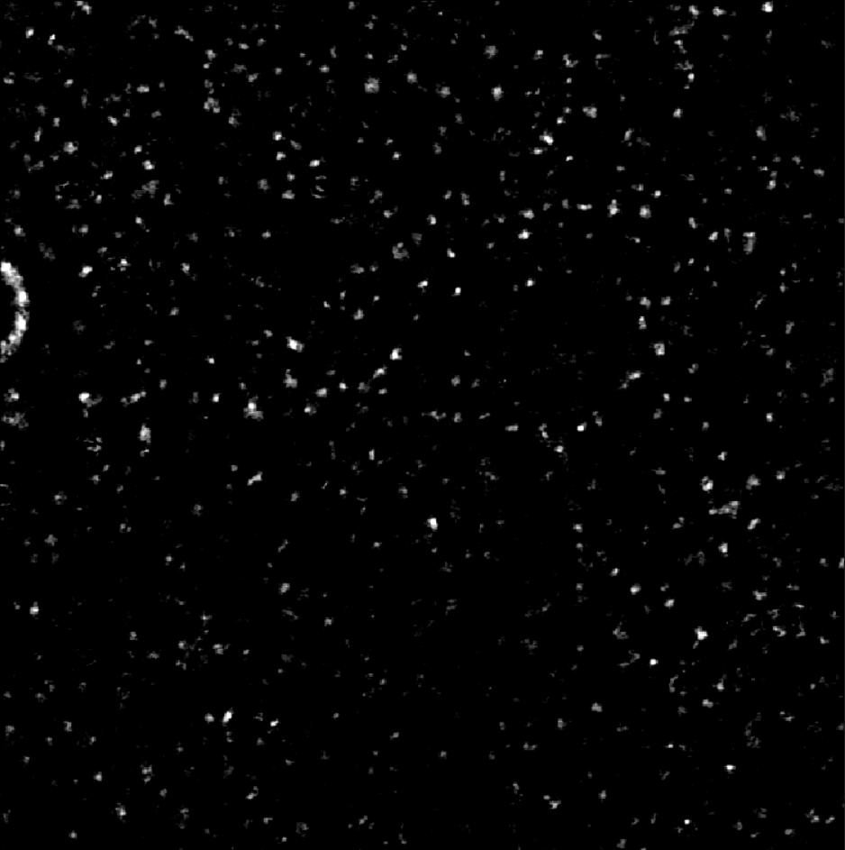

PANORAMA of sample 105
Before wash particles: 569
Large particle: 134
Exosome: 435
After wash exosome: 57
Note: 0% response to miRNA-21
Looks healthy
Scale Bar: 10 µm

